Slide 2

Jack Streatfeild, M. Sc.
Data scientist
studied atmospheric sciences at
Macquarie University, Sydney
LF - Universität, Innsbruck (focus on probabilistic forecasting models)
weather prediction in Switzerland
data scientist at TOWA\\data
How to reach me
jack.streatfeild@towa.at

Slide 3

Python
one of the fastest-growing programming languages (GITHUB)

Slide 4
What is Python and why do we want it?
Python in DataScience
Python vs. R
Exercise
Dataset
Models
Coding

Slide 5

Python is an interpreted, high-level, general-purpose programming language.
Created by Guido van Rossum in 1989

Slide 6









What is it used for?
Data Analysis
Desktop Apps
AI / ML
Mobile Apps
Automation
Testing
Web Apps
Hacking

Slide 7

So?

Slide 8




This is why!
High-level
Cross-platform
Huge community
Large ecosystem

Slide 9

High-level

Slide 10
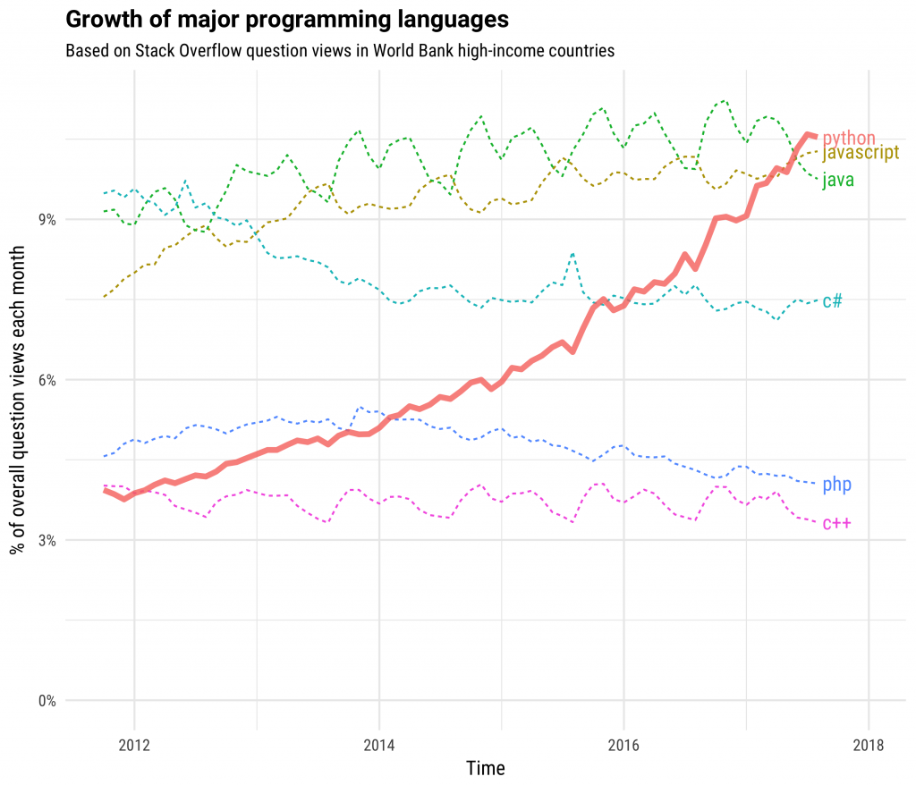
Rapid growing community

Slide 11
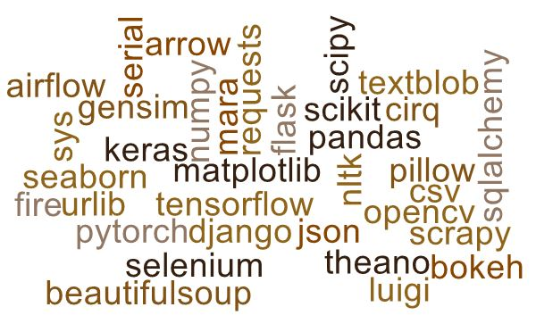
Large Ecosystem

Slide 12
Pillow Matplotlib Numpy Pandas Tensorflow Keras Seaborn Os Sys Django Flask Json Csv Opencv Nltk Requests Urlib Sqlalchemy Cirq Pytorch Selenium Scrapy Bokeh Gensim Scikit Textblob Serial, Beautifulsoup, Theano, Fire, Arrow, Mara, Luigi, Airflow, Scipy

Slide 13

Python in Data Sciene

Slide 14
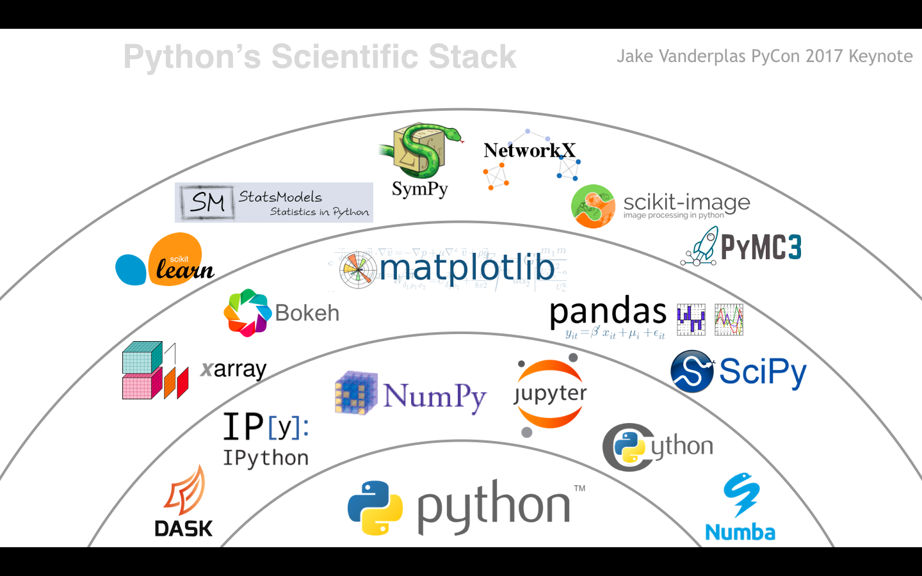
A taste of the scientific frameworks

Slide 15
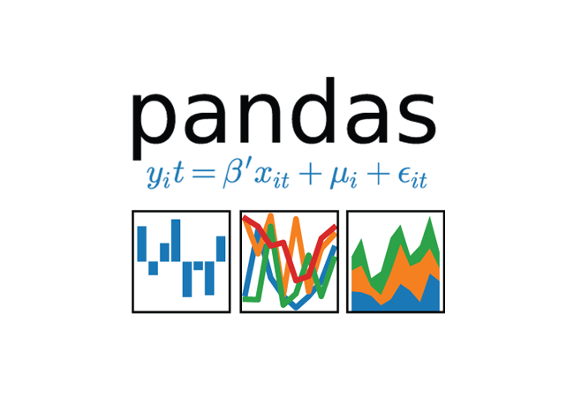

Big Player 1/2
Numpy
pandas
Numpy is Python library that provides mathematical function to handle large dimension array.
Pandas provide useful functions to manipulate large amount of structured data.
Pandas provide easiest method to perform analysis.

Slide 16


Big Player 2/2
matplotlib
Scikit - learn
Matplotlib provides various method to Visualize data in more effective way.
Matplotlib allows to quickly make line graphs, pie charts and other professional grade figures.
SciKit learn is Python library for machine learning.
SciKit learn provides various algorithms and functions that are used in machine learning.

Slide 17

Python vs. R

Slide 18

Superman vs. Batman
General purpose coding, scripting, IoT, better productivity and speed. | Statistical and graphical modelling, analysis.
Effective implementation of algorithms | Effective implementation of statistical models
High flexibility across wide range on applications | Few lines of code for statistical insights
High computational power (GPU) | Not as suitable for machine learning
Developers, data engineers and scientists | Statisticians, analysts and data scientists

Slide 19


Superman vs. Batman
General purpose coding, scripting, IoT, better productivity and speed. | Statistical and graphical modelling, analysis.
Effective implementation of algorithms | Effective implementation of statistical models
High flexibility across wide range on applications | Few lines of code for statistical insights
High computational power (GPU) | Not as suitable for machine learning
Developers, data engineers and scientists | Statisticians, analysts and data scientists

Slide 20
Popularity by StackOverflow (2019)
popular technology
loved
dreaded
avg earings (WW)
41.7% (4)
73.1% (2)
?
$63k
5.8% (17)
51.7% (20)
48.3% (8)
$64k
Python, the fastest-growing major programming language, has risen in the ranks of programming languages in our survey yet again, edging out Java this year and standing as the second most loved language (behind Rust).

Slide 21

Exercise

Slide 22

Dataset

Slide 23
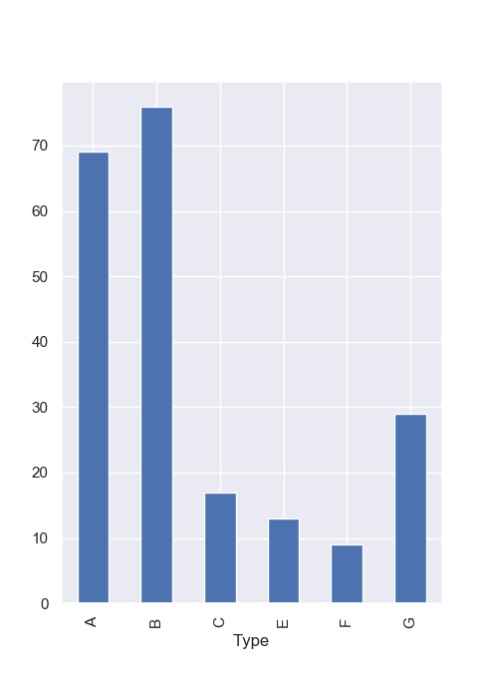
Dataset
https://www.kaggle.com/uciml/glass
Dataset with 214 records
7 different types of glass (categorical)
Described by 9 elements (metric)
Glasstypes:
buildingwindowsfloatprocessed
Buildingwindowsnonfloatprocessed
Vehiclewindowsfloatprocessed
Vehiclewindowsnonfloatprocessed
Containers
Tableware
headlamps

Slide 24

Models

Slide 25
PCA (simple)
y
statistical method to reduce dimensions
Find groups with similarities
z
x
2. PC
1. PC

Slide 26
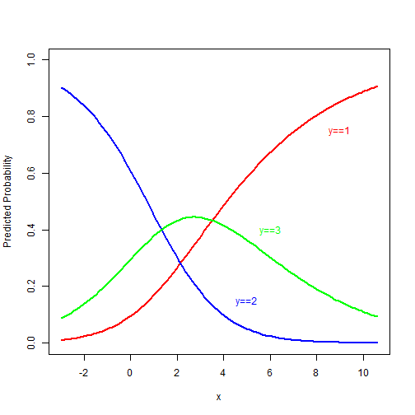
Multinomial Logistic Regression

Slide 27
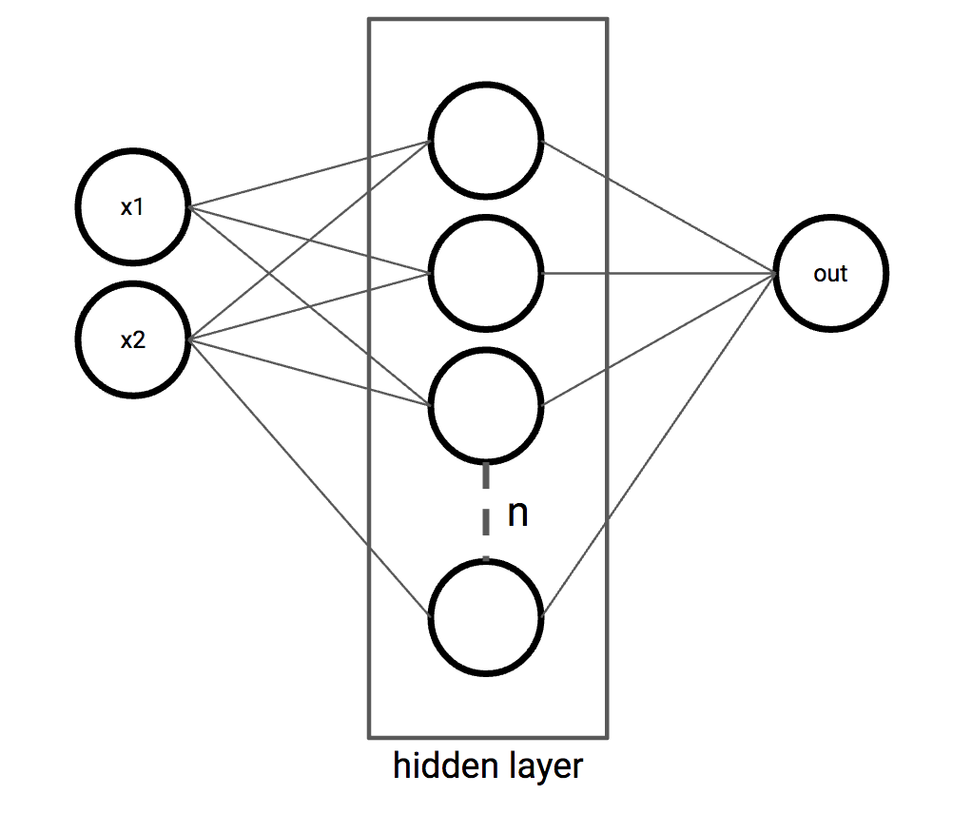
ANN - Classifier

Slide 28

Let’s code (git clone https://ingo_februar@bitbucket.org/ingo_februar/bida_example.git)

